Slide 1
Build MVC apps with Microsoft Graph
Build an ASP.NET MVC web application using Microsoft Graph

Slide 2

Building Microsoft Graph applications
Intro to the Microsoft Graph API
Getting started
SDKs & Code Samples
Resources

Slide 3
Developer vision
USERS
DATA
HTML
Notes:
Our Office 365 developer vision focuses on the Users’ experience and their data. As a developer you can bring your applications into their user experience. With over 1.2+ billion users of Office Worldwide, this is a huge opportunity to provide a window into your applications. As well as being able to connect into their data and add intelligence to your applications. There are currently 850 million events created a month and a total of 470Pb+ of data stored in the service that can add value to for our Users’.

Slide 4
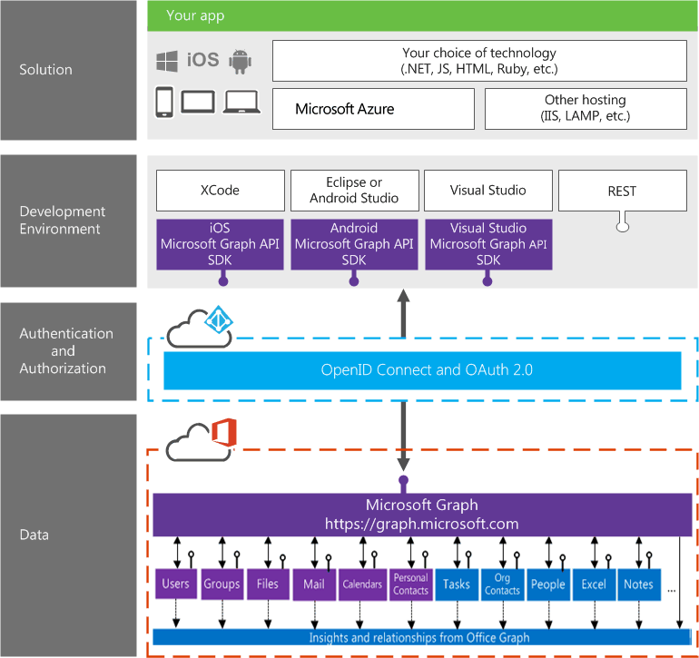
Building integration with Office 365

Slide 5
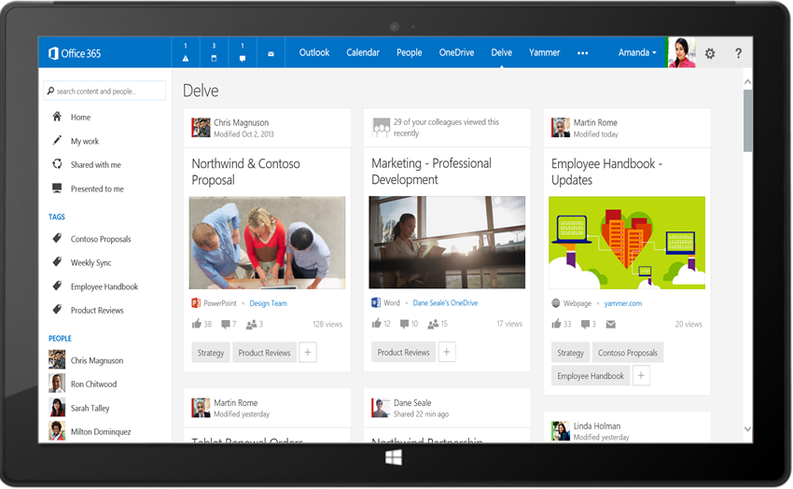
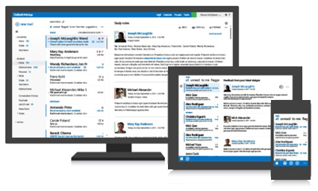
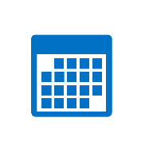



Microsoft Graph API
Your App
https://graph.microsoft.com/
USERS
GROUPS
FILES
MAIL
CALENDAR
TASKS
Insights and relationships from Office Graph

Slide 6
Microsoft Graph, gateway to Office 365
Single resource that proxies multiple Microsoft services
Allows for easy traversal of objects and relationships
Simplifies token acquisition and management
Eliminates the need to traditional discovery (using “me” and “myorganization”)

Slide 7
Office 365 direct API Endpoints
Direct API endpoints for all the Office 365 Services may also be invoked
Outlook, OneDrive, OneNote, etc.
Direct endpoints have new functionality before it is exposed via the Graph API
Examples:
Outlook web hooks
Time zone on calendar

Slide 8
Single authentication flow for Office 365
Sign users in using OpenID Connect
Azure AD and Office 365 services
Supports MFA and federated user sign-in
Device apps, web sites, SPAs, and service apps
Pin apps to Office 365 app launcher from My apps

Slide 9
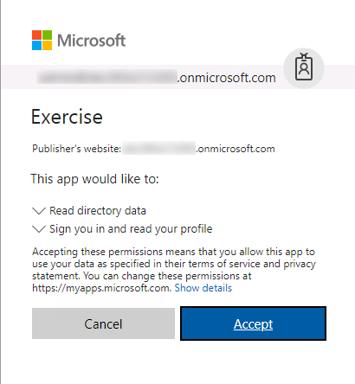
Common consent
Single auth flow for accessing all O365 services
Admin and end-user consent
Secure protocol
OpenID Connect and OAuth 2.0
No capturing user credentials
Fine-grained access scopes
Long-term access through refresh tokens

Slide 10
Authentication Options
Azure AD only
Separate auth flow supports Azure AD accounts only
Azure AD and Microsoft Accounts
Converged auth flow supports Azure AD accounts and Microsoft accounts (LiveID - hotmail.com, etc.)

Slide 11
Microsoft Account + Azure AD
Many apps want to sign users in from both Microsoft account and Azure AD
Single endpoint, OpenID Connect and OAuth 2.0
Single SDK
Single end user sign in experience
Single app registration experience
Works with Microsoft Graph
Single API endpoint, business and consumer data

Slide 12
Integrating with Office 365
Your App
https://graph.microsoft.com/
USERS
GROUPS
FILES
MAIL
CALENDAR
TASKS
Insights and relationships from Office Graph

Slide 13
Creating an ASP.NET web application configured with MSAL & OWIN middleware for authentication with Azure AD

Slide 14
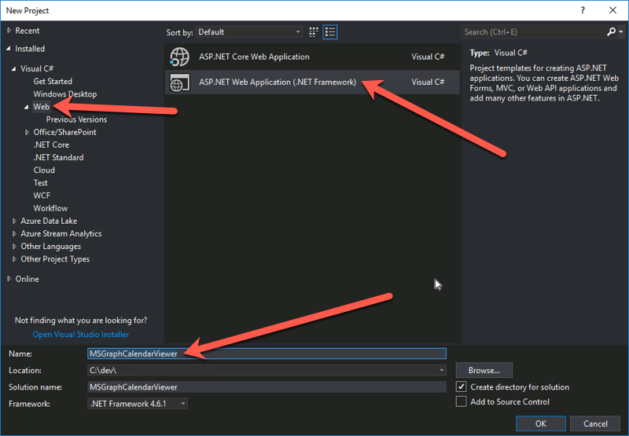
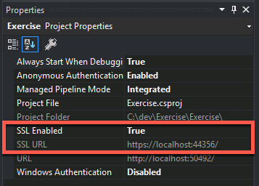
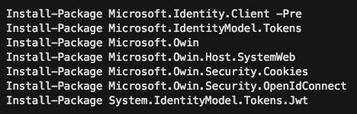
Create ASP.NET MVC Web Application
Create the ASP.NET MVC web application
Do not use the Visual Studio wizard to configure authentication
Configure it to use SSL
The redirect URL must be HTTPS to work with Azure AD applications
Configure it for MSAL & OWIN middleware
This involves installing a few NuGet packages and modifying the project code.

Slide 15
Install NuGet Packages
Microsoft’s Authentication Library (MSAL) & OWIN middleware is distributed using pacakges
The following NuGet packages include MSAL, OWIN middleware and dependent packages:
Install-Package Microsoft.Identity.Client -Pre
Install-Package Microsoft.IdentityModel.Tokens
Install-Package Microsoft.Owin
Install-Package Microsoft.Owin.Host.SystemWeb
Install-Package Microsoft.Owin.Security.Cookies
Install-Package Microsoft.Owin.Security.OpenIdConnect
Install-Package System.IdentityModel.Tokens.Jwt
Notes:
At the time of this writing, the Microsoft.Identity.Client package is pre-release, make sure to include pre-release packages either using the checkbox in the GUI or including the –pre switch on the command line during preview.
Once the production bits are released, make sure to use the production version.

Slide 16
Demo

Slide 17
Thank you.

